Slide 1
Visual Analytics– Prototyping
Dr. Ab Mosca (they/them)
Slides based off slides courtesy of Jordan Crouser (https://jcrouser.github.io/)

Slide 2
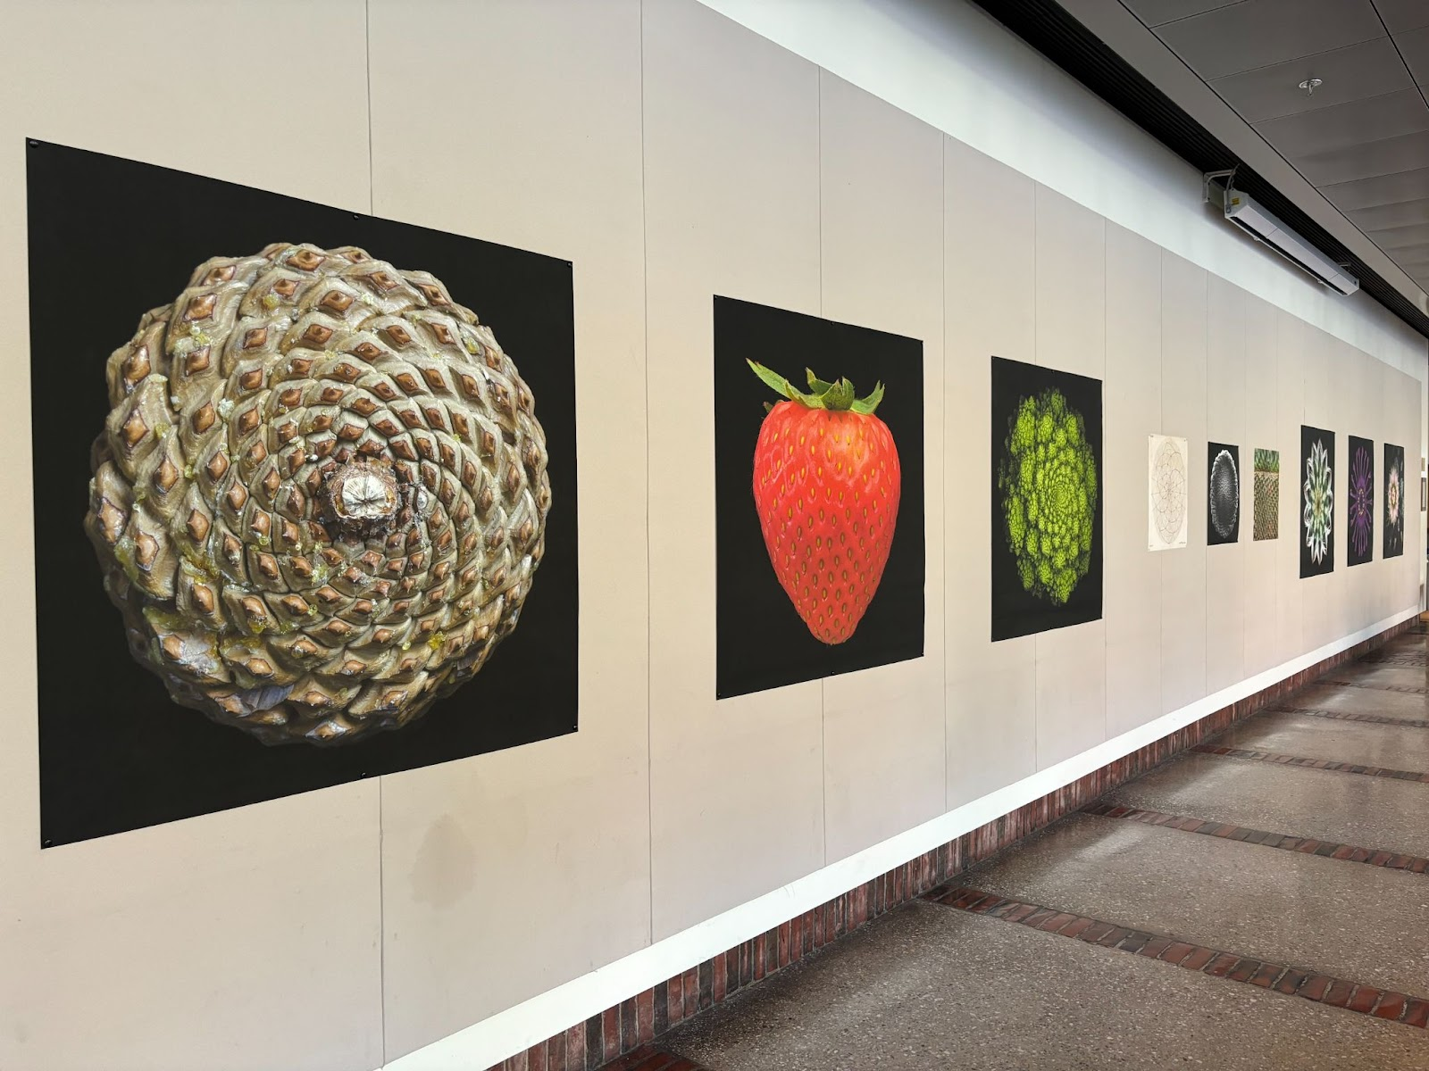
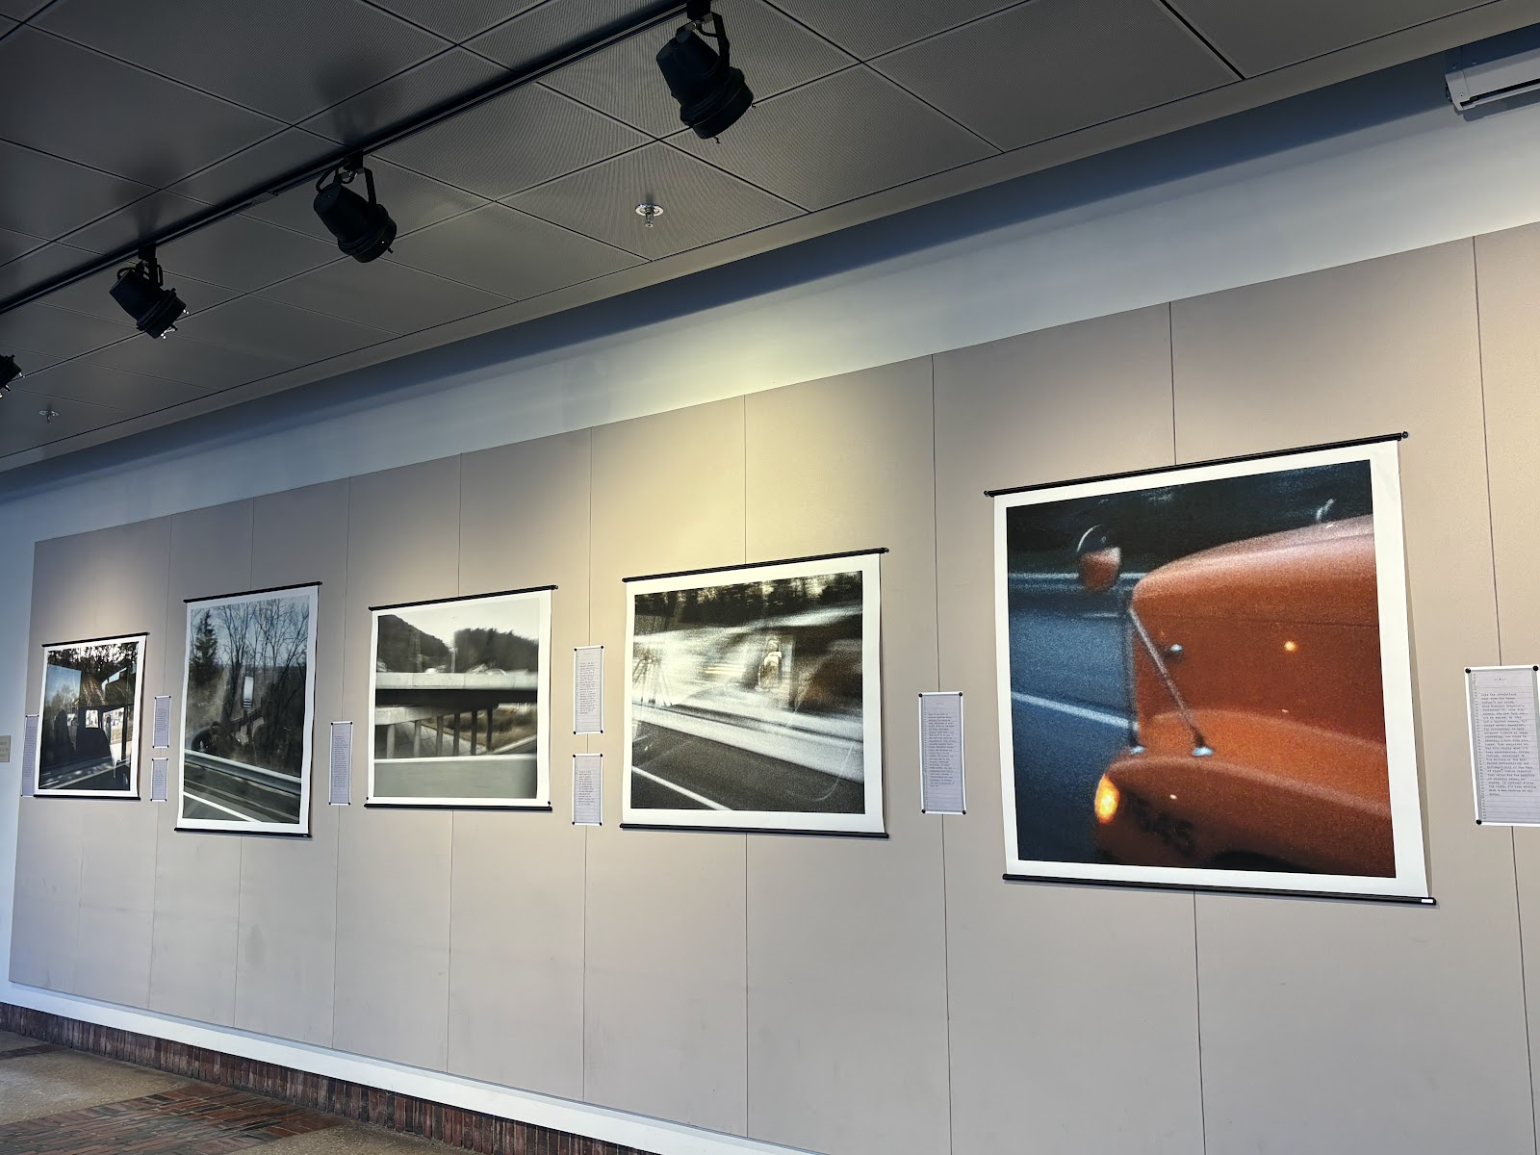
Announcements
Smith Office for the Arts (SOFA) is accepting proposals for the McConnell Foyer Gallery
I think a visualization installation would be a great fit for the space. If you’d like to brainstorm and submit a proposal with me, please reach out on Slack
Do Plants Know Math?: Unwinding the Story of Plant Spirals from Leonardo to Now
BUS: A Teacher in Transit

Slide 3
Reminders
No Class Tuesday (11/12) because it is Cromwell Day
Final Project released today!
Be prepared to perform prototype testing for your project in class on 11/14

Slide 4
Plan for Today
User-centered design
What it is
Why do it
Ways to do it
Architecture diagrams
Paper prototypes

Slide 5
Hypothetical Example
“Where should I get lunch?”
Notes:
https://scenarioviewer.nrel.gov/

Slide 6
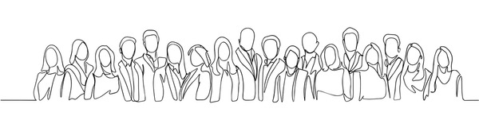
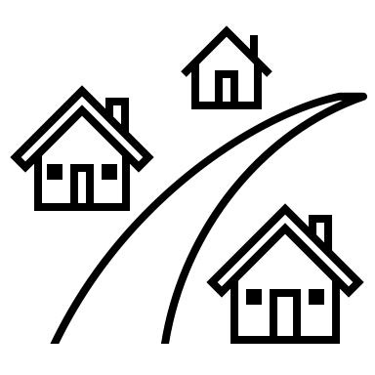


Hypothetical example
Overview: ~2500 students to feed, 75 min lunch block, 10 dining halls
https://www.google.com/url?sa=i&url=https%3A%2F%2Fwww.shutterstock.com%2Fsearch%2Fcrowd-drawing&psig=AOvVaw2M81sGf2JwKjfwSdQQ14ql&ust=1729607623924000&source=images&cd=vfe&opi=89978449&ved=0CBQQjRxqFwoTCIDZ_eTYn4kDFQAAAAAdAAAAABAE

Slide 7
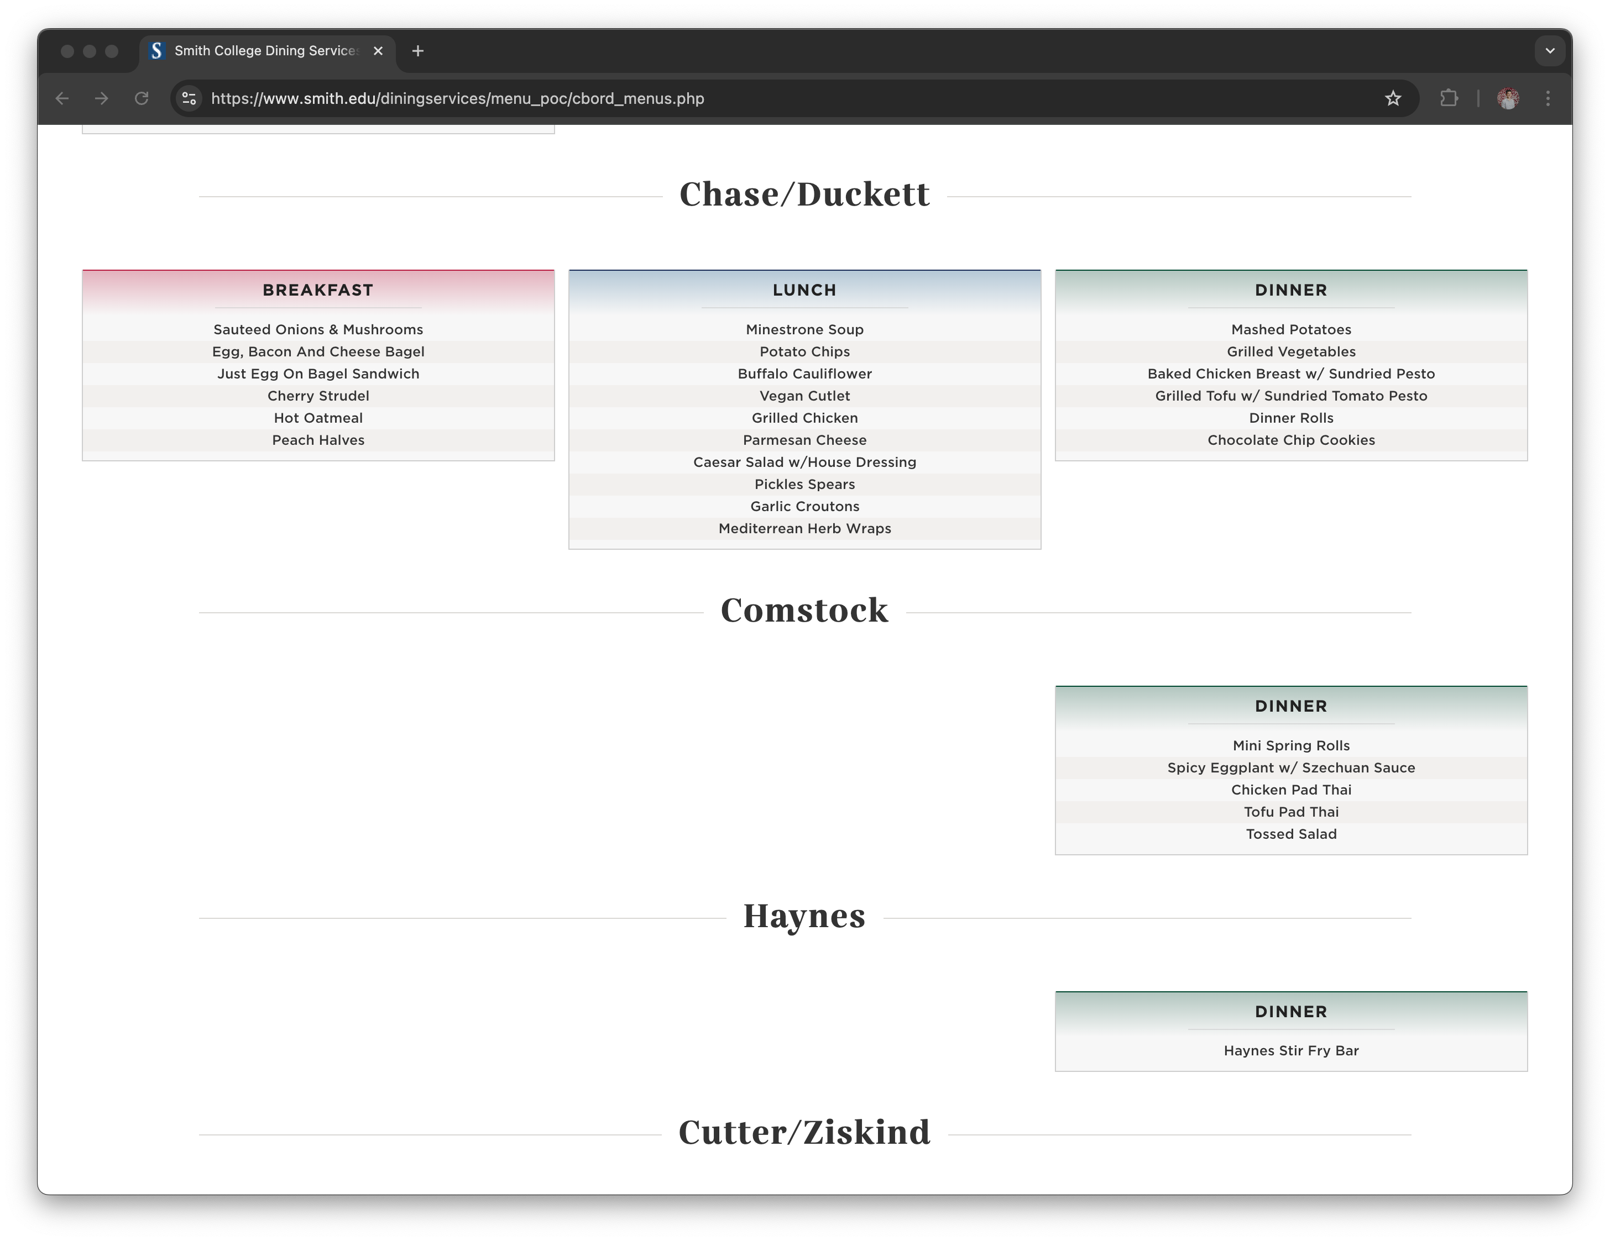
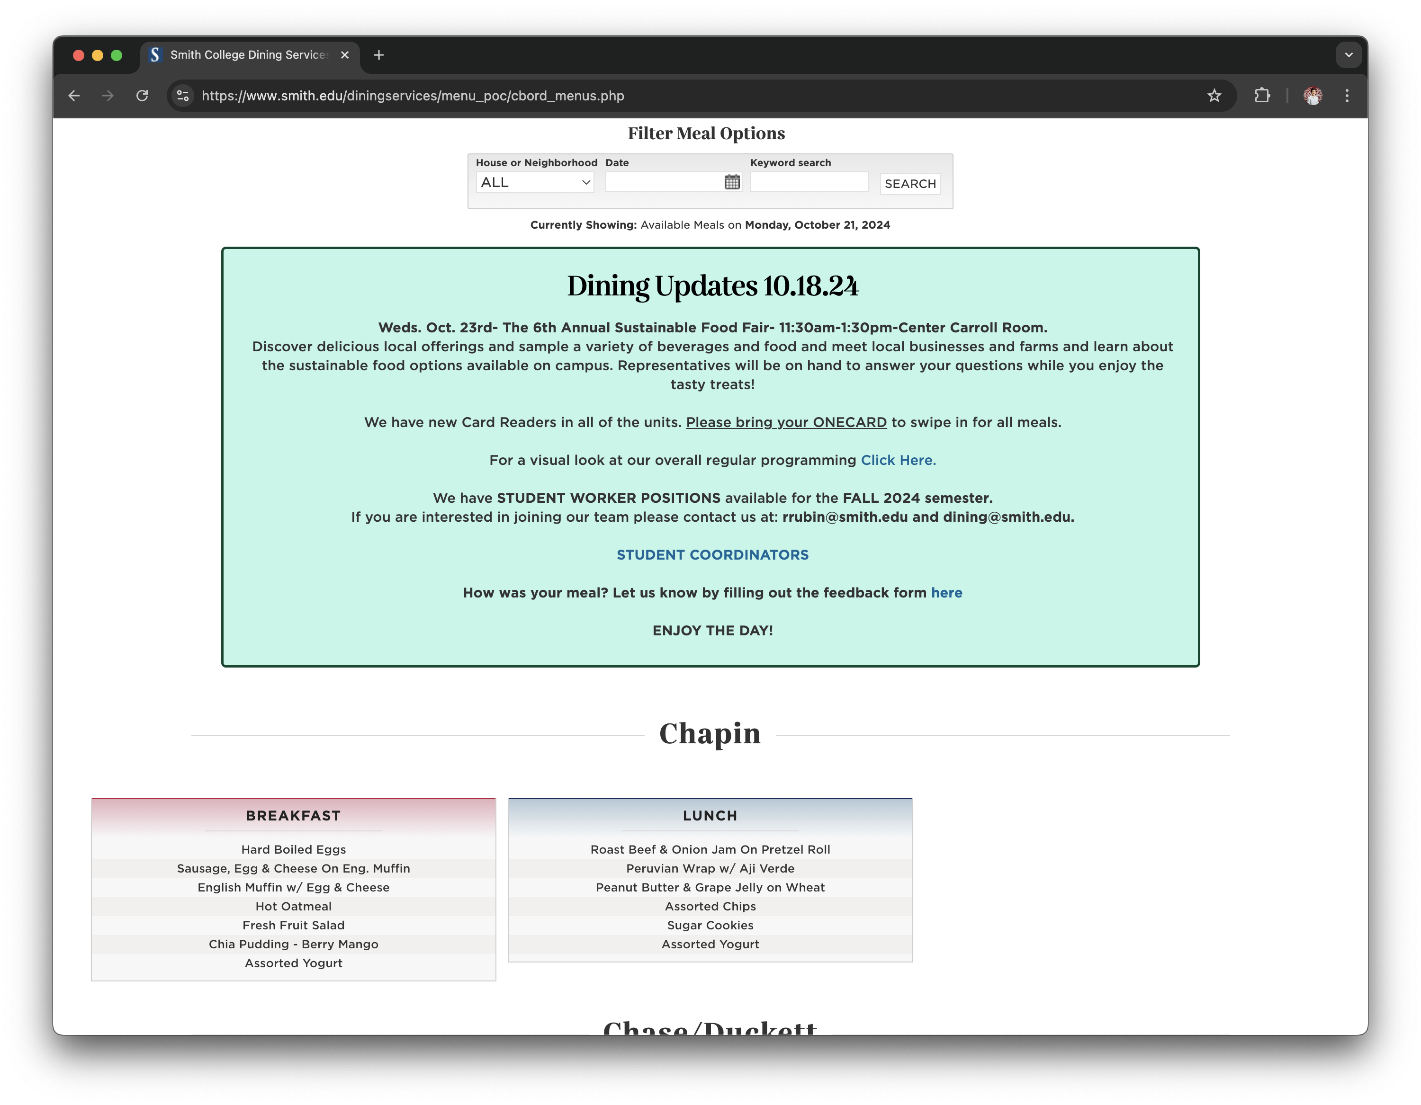
Hypothetical example
Overview: Menu page is not very helpful…
Notes:
Date is super small
I see all meals, not just appropriate one
If I scroll I see all halls, not just open ones
I can’t see where has the same food
I can’t see where on campus each is
Can’t see how busy each is

Slide 8
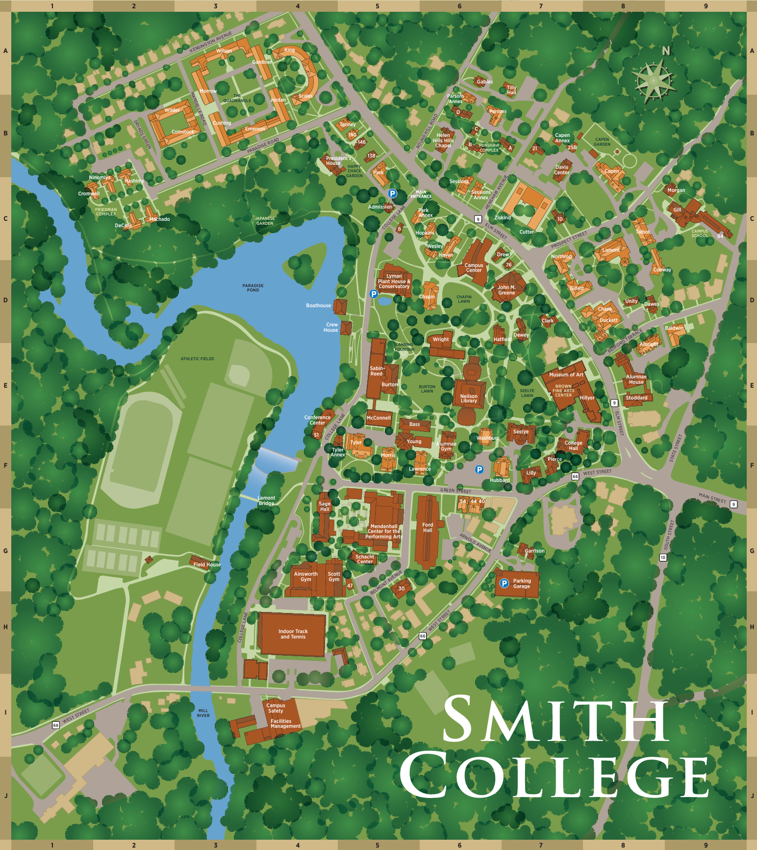
Hypothetical example
Overview: current process is manual
Goal 1: Automatically show only open dining halls
Goal 2: Give an overview of locations and repeat menus
Goal 3: Show how busy open dining halls are

Slide 9
Hypothetical example
Ideal: we would like to build an application that pulls data from the menu page, campus map, and location data to show open dining halls, menus, and business
Issue: Big brother vibes, privacy concerns, disparate data sources
Strategy:
Scrape data from menu page
Find shapefiles for campus map
Combine data sources
Build authenticated front-end for current Smithies
Ideal: we would like to build an application that pulls data from the menu page, campus map, and location data to show open dining halls, menus, and business

Slide 10
Hypothetical example
Ideal: we would like to build an application that pulls data from the menu page, campus map, and location data to show open dining halls, menus, and business
Issue: Big brother vibes, privacy concerns, disparate data sources
Strategy:
Scrape data from menu page
Find shapefiles for campus map
Combine data sources
Build authenticated front-end for current Smithies
Ideal: we would like to build an application that pulls data from the menu page, campus map, and location data to show open dining halls, menus, and business

Slide 11
Discussion
Let’s say you want to implement this front-end; where do you start?

Slide 12
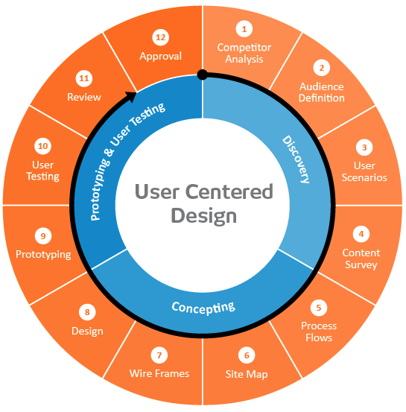
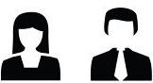
User-centered design framework
1) Discovery
Learning about your users
Modeling your users
Analyzing your users’ tasks
Eliciting and defining clear product requirements
2) Concepting Phase
Developing conceptual models
Solving design problems through ideation
Detailed design activities
3) Prototyping + User Testing
Delivery of a high-quality product that meets users’ needs and is easy to learn and use
Users
http://www.uxmatters.com/mt/archives/2010/07/design-is-a-process-not-a-methodology.php
Notes:
All Phases
Each phase feeds into the next
Iteration is key!
Users involved at all phases of the process

Slide 13
Discovery: Competitor Analysis
Why?
If you look at what already exists, you might be able to identify potential issues in advance
Also helps establish your unique contribution
How?
Literature or product review
Analysis
What are the existing tools?
What is their purpose?
What audience are they aiming for?
What kinds of strategies are they using?
What functionality do they contain?
What are their strengths and shortcomings?
Identify opportunities and design constraints

Slide 14
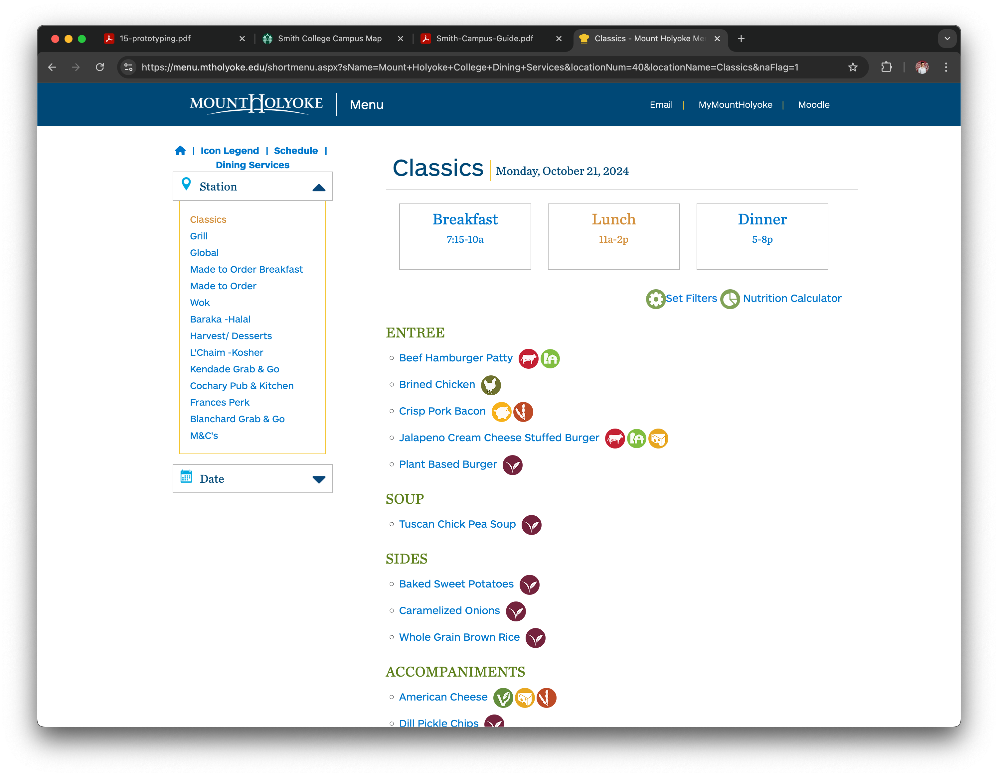
Discovery: Competitor Analysis
Why?
If you look at what already exists, you might be able to identify potential issues in advance
Also helps establish your unique contribution
How?
Literature or product review
Analysis
What are the existing tools?
What is their purpose?
What audience are they aiming for?
What kinds of strategies are they using?
What functionality do they contain?
What are their strengths and shortcomings?
Identify opportunities and design constraints
Notes:
Should we use icons for extra info?

Slide 15
Discovery: Audience Definition
Learning about their problem
Semi-structured interview
Analyzing their tasks
Hierarchical task analysis
Modeling users
Personas

Slide 16
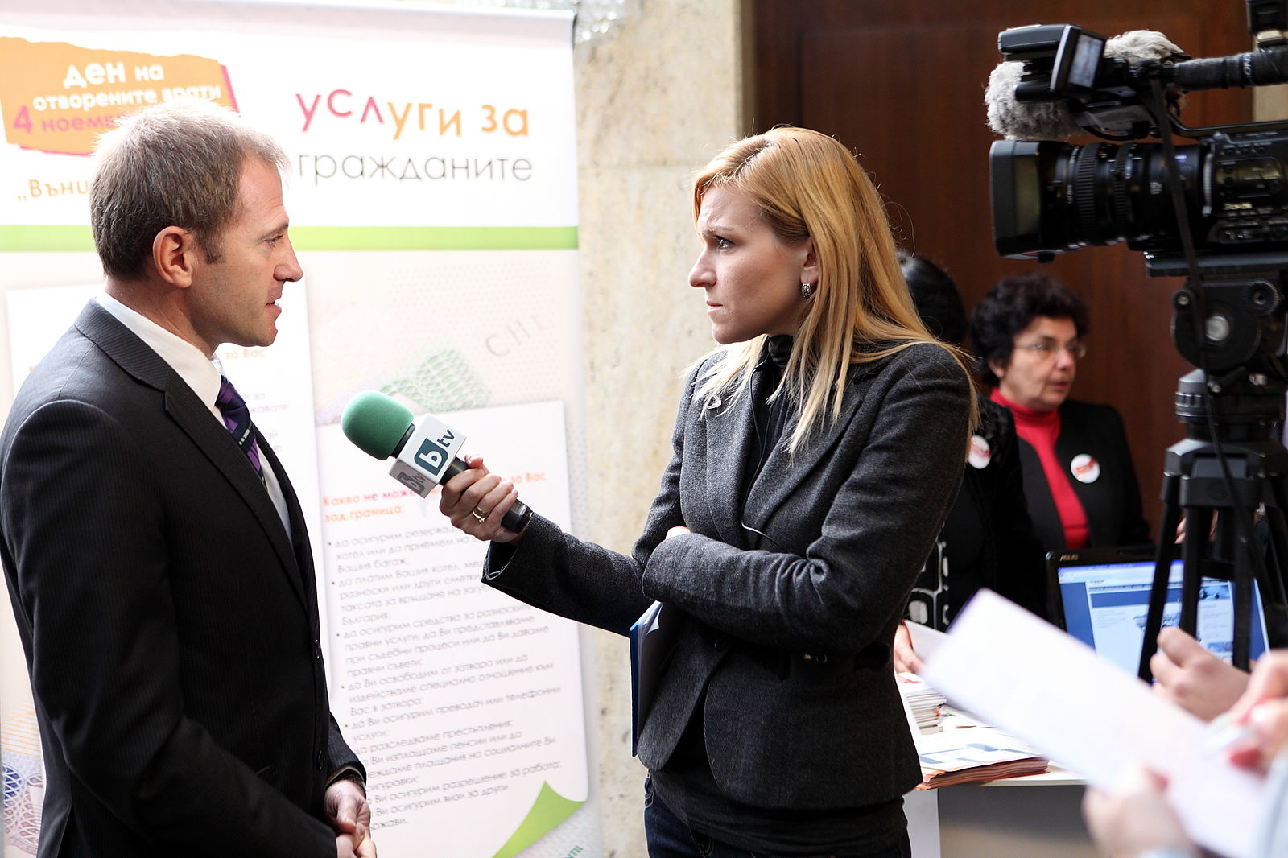
Semi-structured interviews
Why?
gather qualitative data about users to understand the problem
can help identify key differences between designer and target user
How?
ask open-ended questions
bring along a “cheat sheet” to
ensure that you gather all the
information you need
Some tips:
establish trust at the beginning
participant engagement will vary
be flexible, but make sure you get what you came for
consider recording or note-taking to help with recall
Wood, L. E. (1997). Semi-structured interviewing for user-centered design. interactions, 4(2), 48-61.

Slide 17
Hierarchical task analysis
Why?
Understand user workflow
Identify pain points and areas for optimization
How?
Decompose tasks into 4-8 sequential steps
Identify patterns, sequences and skips in the tasks
An example:
Hackos, J. & Redish, J. (1998). User and Task Analysis for Interface Design. Chichester: Wiley.

Slide 18
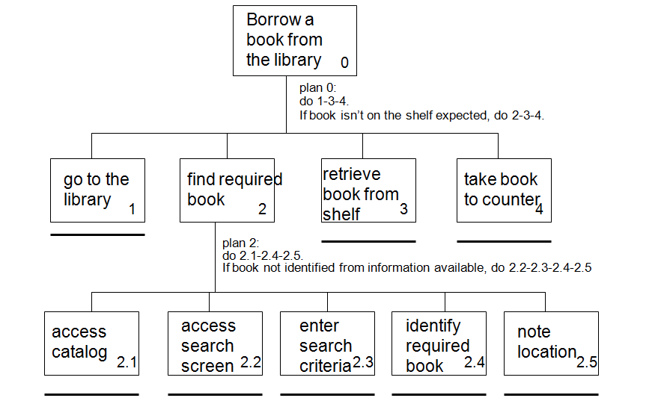
Task analysis example
http://i1206241.blogspot.com/2013/01/task-descriptions-hierarchical-task.html

Slide 19
Personas
Why?
mechanism for reasoning about user needs
model behavioral characteristics of target users
doesn’t require access to ACTUAL users
How?
fictionalization
narrative, goals, needs, “pain points”
attributes specific to the problem space
data-driven method* using info from interviews
mapping persona to software features

Slide 20
Personas
Example for the dining app
Ellis is a first year Smithie who lives in in Wilson. They do cross country and have 6am practice before their 9:25am art history class in the art museum on MWF. On TR, they have engineering 101 in Ford Hall until 12:05, and their work study job at the campus school that starts at 12:45pm sharp. Ellis is a “live to eat” kind of person, and likes to optimize the ”yum” factor in their meals. In addition, they are vegan. They are comfortable using apps on their phone like GoogleMaps, but are struggling to find the time to survey dining hall menus and get to the appropriate dining hall for the meal they want between their various other activities.
Pain Point: Limited time
Goal/Need: Eating what they like
Pain Point: Limited time
Pain Point: Distilling current menu list
Goal/Need: Minimize walk distance
Technical skills: Comfortable with basic apps
Pain Point: Walking far & fast

Slide 21
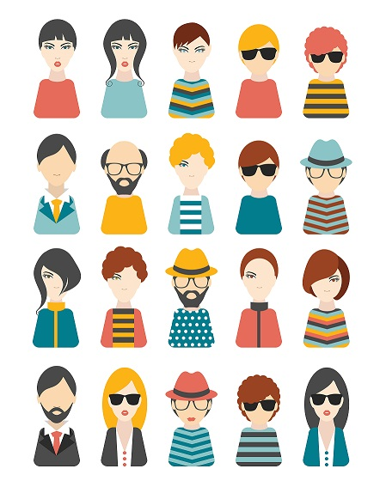
Activity: personas
Goal: come up with a persona that characterizes a user of a visual analytic system for exploring energy usage on campus.

Slide 22
Now that we’ve got some end users in mind,
what would the system look like?

Slide 23
User-centered design framework
1) Discovery
Learning about your users
Modeling your users
Analyzing your users’ tasks
Eliciting and defining clear product requirements
2) Concepting Phase
Developing conceptual models
Solving design problems through ideation
Detailed design activities
3) Prototyping + User Testing
Delivery of a high-quality product that meets users’ needs and is easy to learn and use
Users
http://www.uxmatters.com/mt/archives/2010/07/design-is-a-process-not-a-methodology.php
Notes:
All Phases
Each phase feeds into the next
Iteration is key!
Users involved at all phases of the process

Slide 24
Concepting: Architecture diagrams
Big idea:
Now that you’ve got an idea of what your too should do, break that down into manageable pieces so you can get started
This can happen at several levels of detail

Slide 25
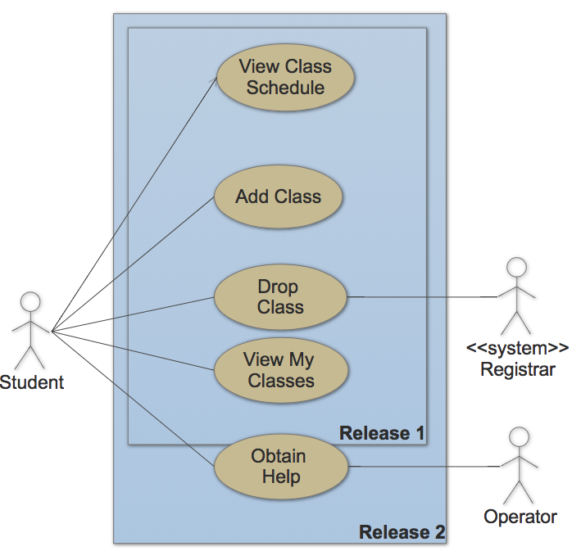
Example: use case diagram (high level)

Slide 26
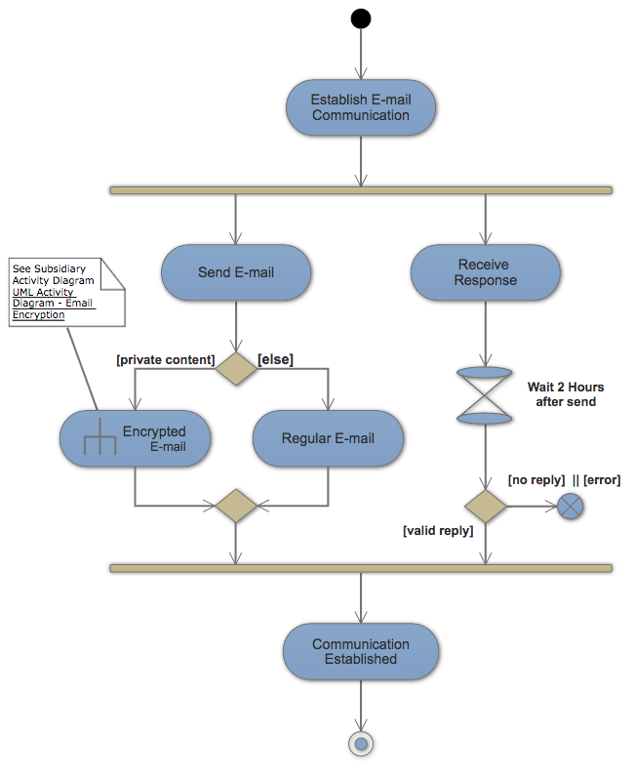
Example: activity diagram (mid level)

Slide 27
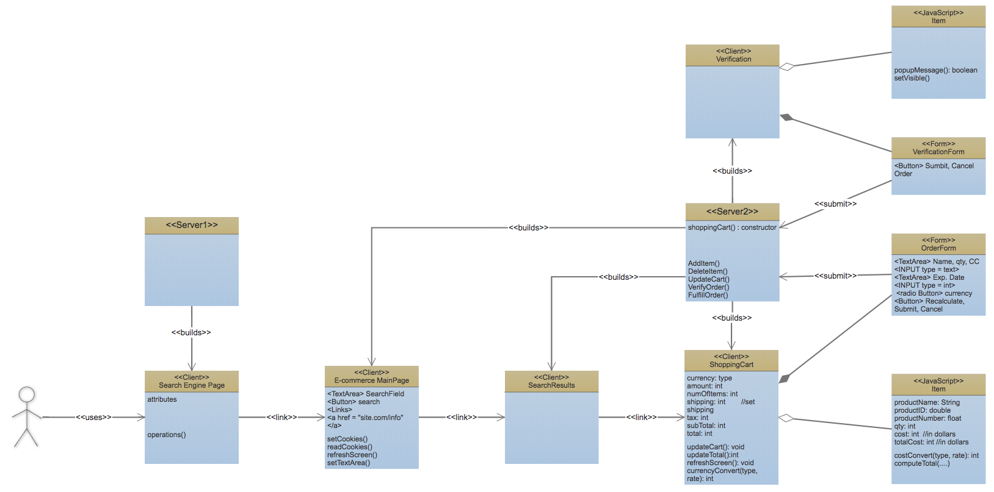
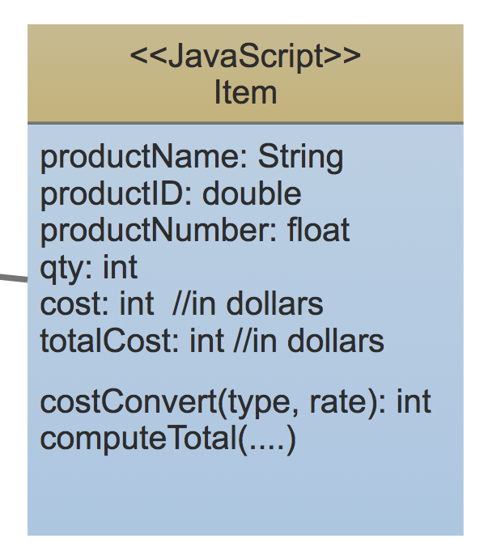
Example: class diagram (low level)

Slide 28
Diagram Practice
What would the case diagram look like for the dining hall app?
What about an activity diagram?

Slide 29
User-centered design framework
1) Discovery
Learning about your users
Modeling your users
Analyzing your users’ tasks
Eliciting and defining clear product requirements
2) Concepting Phase
Developing conceptual models
Solving design problems through ideation
Detailed design activities
3) Prototyping + User Testing
Delivery of a high-quality product that meets users’ needs and is easy to learn and use
Users
http://www.uxmatters.com/mt/archives/2010/07/design-is-a-process-not-a-methodology.php
Notes:
All Phases
Each phase feeds into the next
Iteration is key!
Users involved at all phases of the process

Slide 30
Prototyping and Testing: Low-fidelity paper prototyping
Big idea:
Not sure yet whether or not an idea will work?
Making a paper version of an interface is a lot faster and easier than coding a working prototype – start there!

Slide 31
Prototyping and Testing: Low-fidelity paper prototyping
Generate lots of ideas
Engage other people in the design process
Identify potential problems before you waste time coding
Get feedback quickly, from lots of different people
Some tips:
Focus on the big picture, don’t worry about the details
Think about what you want it to do, rather than what you know how to implement (we’ll worry about that later)
Not so into arts and crafts? It doesn’t have to be actual paper… Whiteboard / PowerPoint / Keynote will also do the trick!

Slide 32
Prototyping and Testing: Soliciting feedback
One purpose of a prototype is to get feedback on your design idea. We do this through user testing:
Choose specific tasks your end user should be able to do with your app
Ask someone to perform those tasks with your prototype
Do not give clues or help while they perform each task
Ask the tester to “think out loud” i.e. narrate what they are doing / why
Observe where they get stuck and what they like
Modify your design based on testing
What tasks could we ask a user to perform to test the dining hall app design?

Slide 33
Prototyping and Testing: Low-fidelity paper prototyping
Examples:
https://www.youtube.com/watch?v=nA9QP9lkl20
https://www.youtube.com/watch?v=y20E3qBmHpg
https://www.youtube.com/watch?v=yafaGNFu8Eg

Slide 34
Prototyping and Testing: Medium & High Fidelity
Medium-fidelity prototype
Typically made once design is more solidified
Usually does not involve coding
Could be made with:
Powerpoint
Canva
Figma
Etc..
Same idea -- build, test, adapt
High-fidelity prototype
Once you have a solid idea of the design, code your app
Test and adapt
You might implement one feature at a time

Slide 35
Your turn!
Work with the group you developed a persona with
Sketch out the visual analytic system you’d make based on your persona
Build a paper prototype of the system
Choose 1 task to have another group perform with your prototype
Pay attention to where they run into trouble
Notes:
Create a paper prototype for a transit app

Slide 36
Takeaways
Thinking about your end user early → you’re more likely to build something that actually solves the problem
“Low-fidelity” prototyping saves time and energy by helping identify problems before you commit to code
Architecture diagrams help you plan out your implementation so you don’t run out of time
Also, the process is kinda fun…

